Slide 1
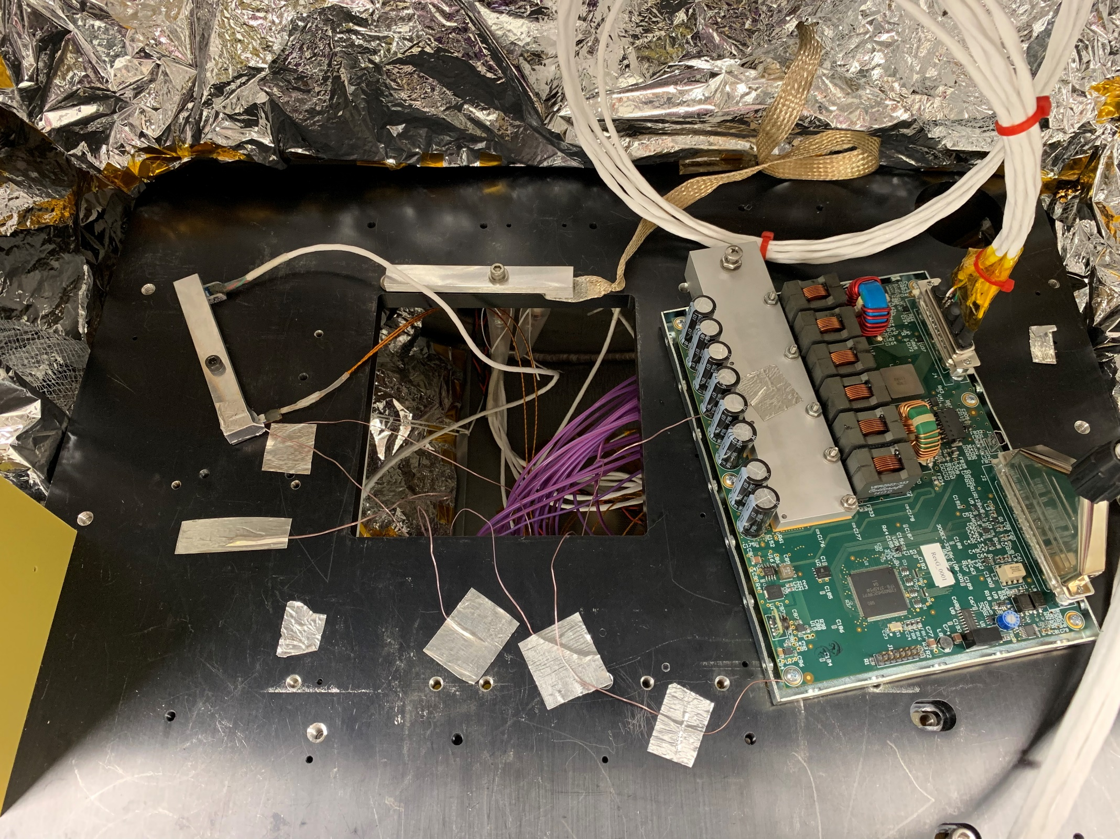
Sunpower AVC controller in TVAC
Heat sink
temperature
TI Concerto
Microcontroller
100 MHz ARM-M3
-40C to 105C T_{J}
PCB
temperature
Feedthroughs allow power, communication, and cryocooler drive
Cryocooler outside chamber allows realistic load on controller
Custom heat sink allows cooling/heating PCB, power transistors, caps

Slide 2
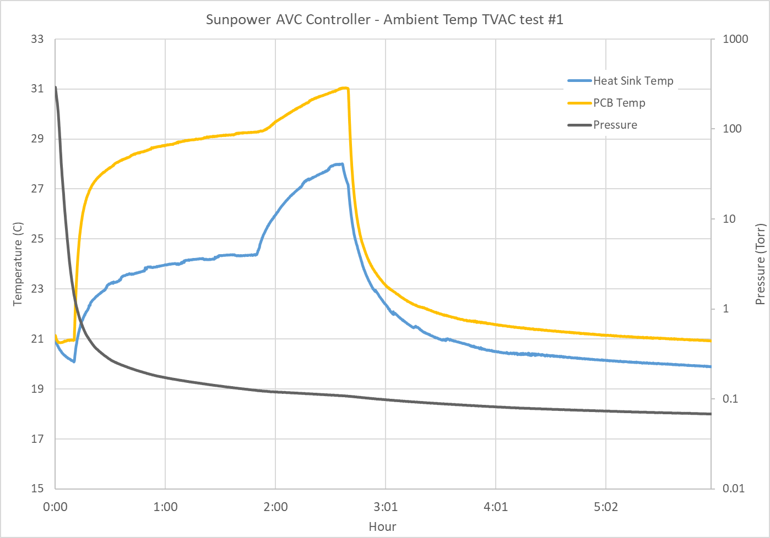
Ambient temperature vacuum test
24V supply ON
45min @ 60W drive
24V supply OFF
3 mbar flight level
Ambient temperature run (no control)
Chamber below flight pressure for entire test.
Left at low pressure overnight post-test, and powered ON at 60W drive
Test was Successful

Slide 3
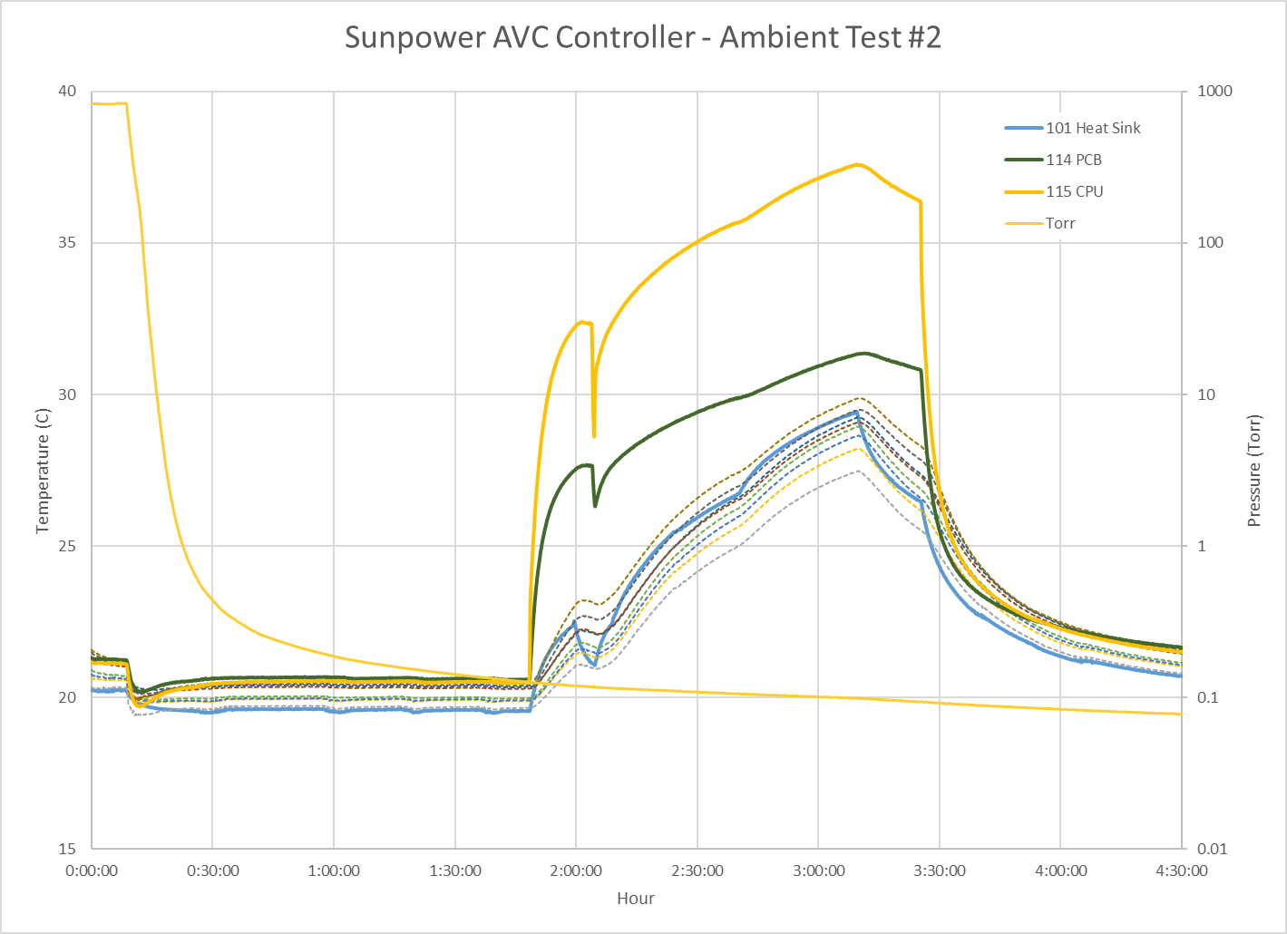
Ambient temperature vacuum test
24V Power ON
Command 60W (anomaly)
24V reset & command 60W
command 90W
Command OFF & 25V Power OFF
A
B
C
D
E
Ambient temperature run (no control)
Chamber below flight pressure for entire test.
Left at low pressure overnight post-test, and powered ON at 60W drive
Test was Successful – One anomaly

Slide 4
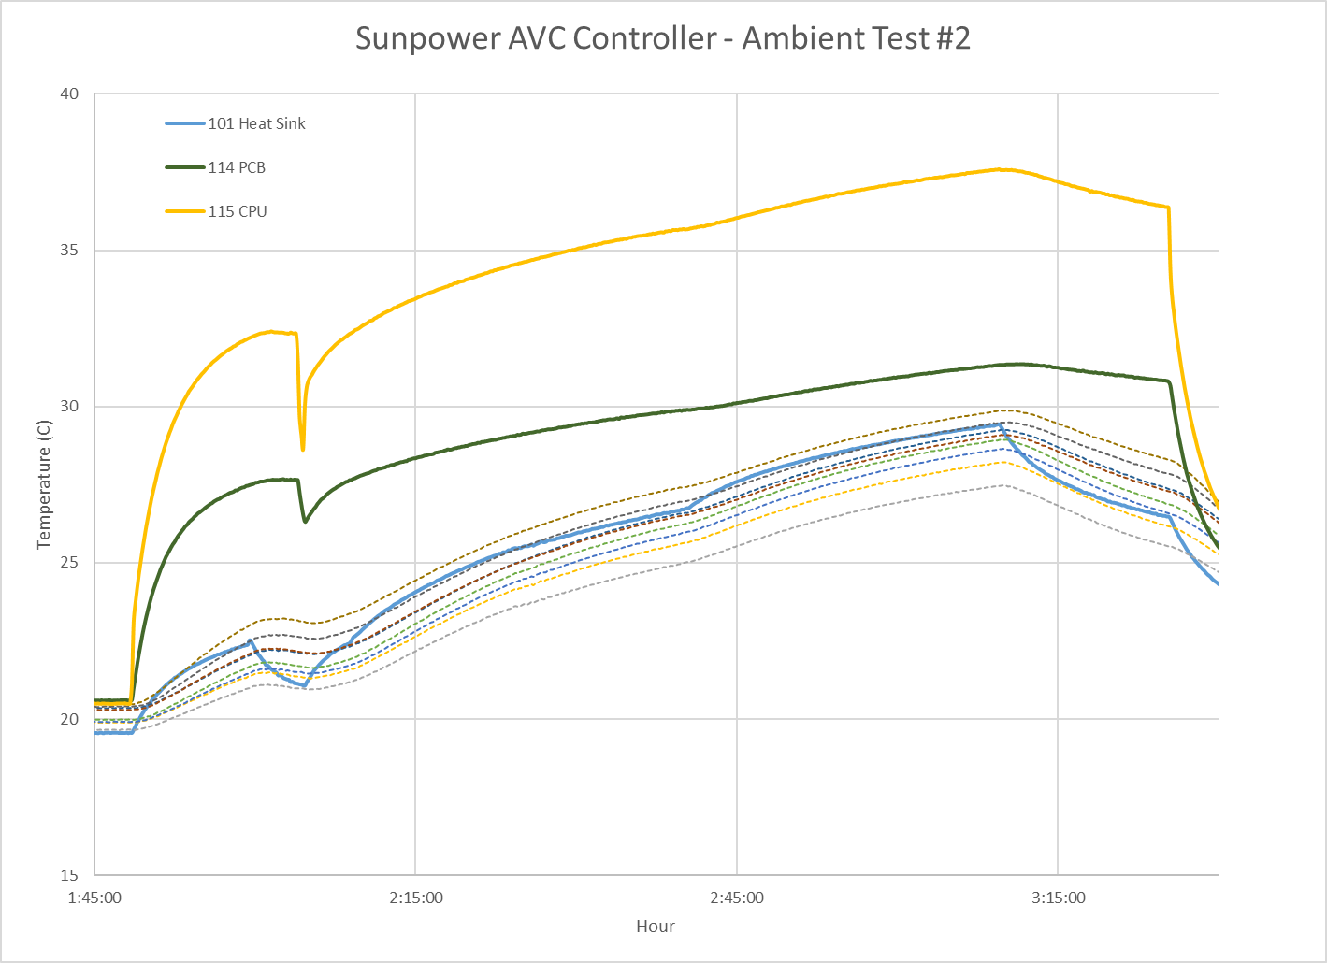
Test # 2 anomaly discussion
When 60W is initially commanded ON, the heat sink and capacitor bank temperature drops, and the cryocooler does not cool.
Serial interface erroneously reports 60W drive and non-zero Hi / Low drive limits
A 24V power cycle is required to turn on at 60W drive.
This failure has been seen previously at random intervals on the bench at ambient pressure.

Slide 5
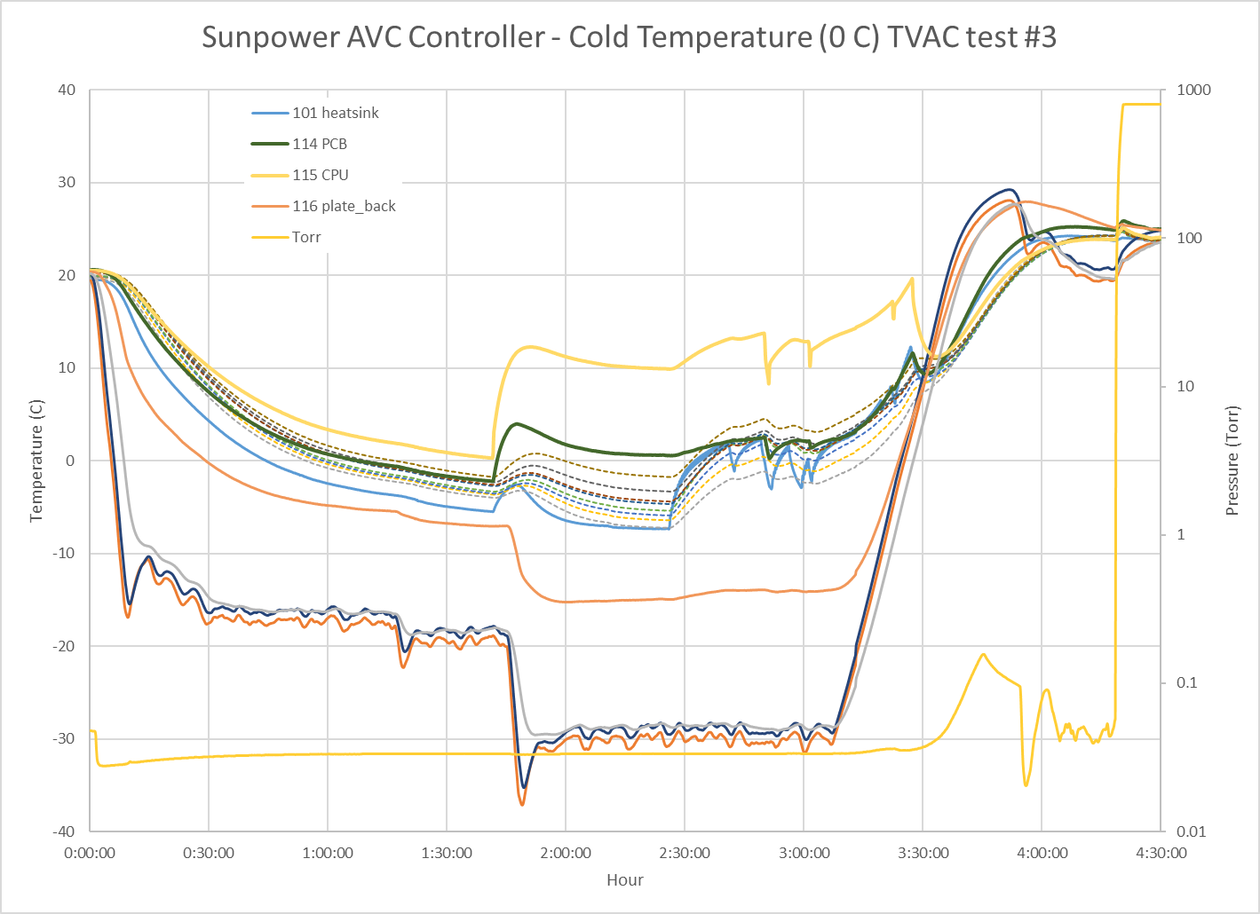
Cold start test
24V Power ON at CPU = 0C
Command 60W
Multiple 24V power cycles and failures
Warm up to 10C
Multiple 24V power cycles and failures at > 10C
A
B
C
D
E
Zero Celsius temperature control
Chamber below flight pressure for entire test.
Test was unsuccessful – unit failed to power on when cold.
After warmup, unit still did not power on.

Slide 6
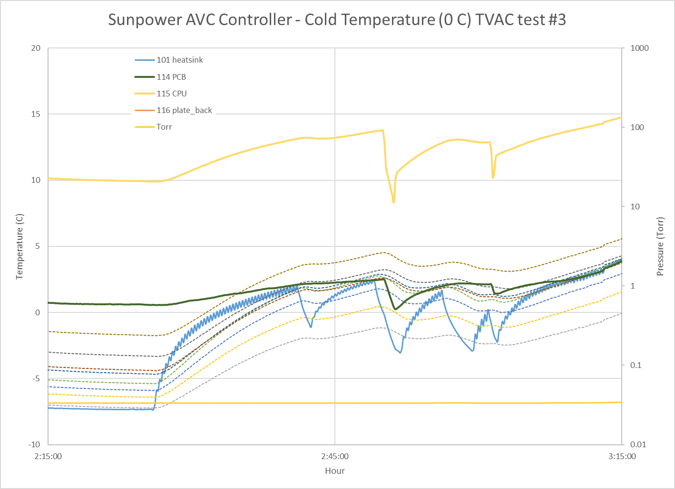
Cold Test failure discussion
With 24V power on, command 60W drive. No start. Once every 20 seconds, 1V DC drive is placed on the cooler, raising the heatsink temperature briefly.
Commanded 0W, then 60W. No start.
24V power cycle
Warm up chamber.
Command 60W. No start.
A
B
C
D
E
In contrast to the previous cooler failure to start, this time there is a periodic 1V pulse on the cooler, and heatsink temperature increase.
In contrast to the previous cooler failure to start, the serial interface reports a 0W hi / low drive limit, and 0W command.
24V power cycle does not fix the issue.
After warm up to 25C board temperature, unit does not start.

Slide 7
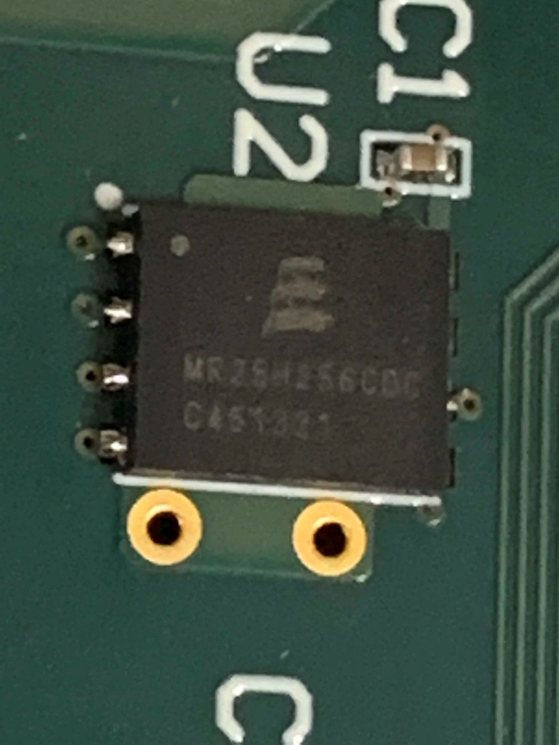
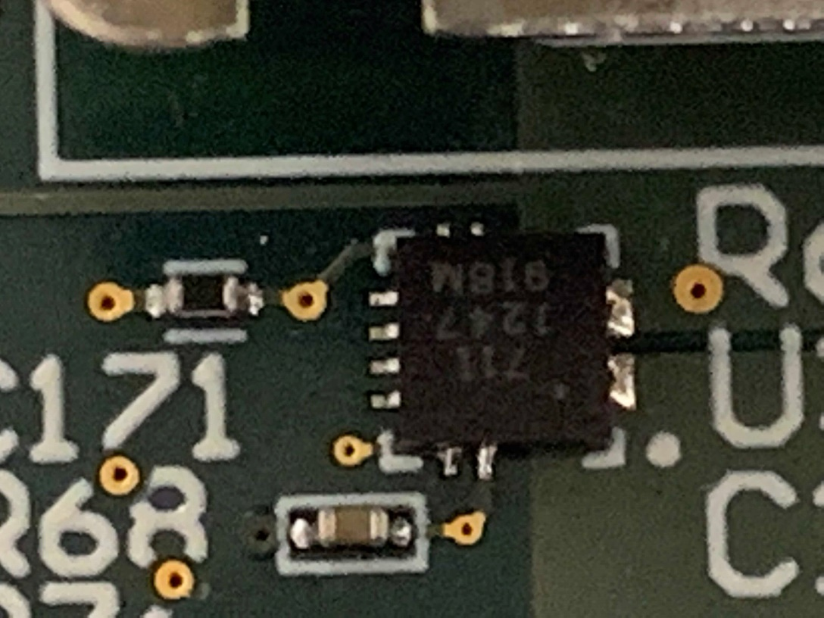
Potential issues
U2 – Everspin MR25H256CDC
256kB SPI MRAM
Industrial temp -40-85C, 8-pin DFN
Q: Does this memory store the Hi/Low drive limit look up table?
U3 – Allegro Micro ACS711 (qty 2)
Hall-Effect current sensor
Datasheet seems to indicate it is internally temperature compensated to -40C
U1 – TI F28M35H52C1RFPT MCU
100 MHz ARM-M3, T-option: -40-105C Junction temp.
Timing of SPI bus could be upset at low temps

